Slide 1
Employee Management System
Java Project | Object-Oriented Programming

Slide 2
Overview
This project demonstrates a simple Employee Management System developed using Java.
It follows object-oriented principles and provides CRUD operations to manage employee data.
The system can add, update, delete, and display employee information, and calculate salaries based on roles.

Slide 3
Package Structure
• p1 - Contains Employee classes (Employee, HR, Admin, SalesManager)
• p2 - Contains MainApp class with menu-driven program
• p3 - Contains EmployeeDAO class for data management

Slide 4
Class Descriptions
• Employee (Abstract): Base class defining id, name, and salary.
• Admin: Adds allowance; calculates salary including allowance.
• HR: Adds commission; calculates salary including commission.
• SalesManager: Adds target & incentive fields.
• EmployeeDAO: Manages employee records via ArrayList.
• MainApp: Handles menu and user interaction.

Slide 5
Program Flow
1. EmployeeDAO initializes employee list.
2. MainApp displays a menu to the user.
3. User can perform:
- Add, Search, Update, Delete employee
- Display all employees
- Calculate salary for each employee
4. Output shown in console.

Slide 6
Sample Console Output
===== Employee Management Menu =====
1. Add Employee
2. Search Employee
3. Update Employee
4. Delete Employee
5. Display All Employees
7. Calculate Salary of Each Employee
0. Exit
Sarthk → Final Salary: 55000.0
Pragati → Final Salary: 80000.0
Exiting... Goodbye!

Slide 7
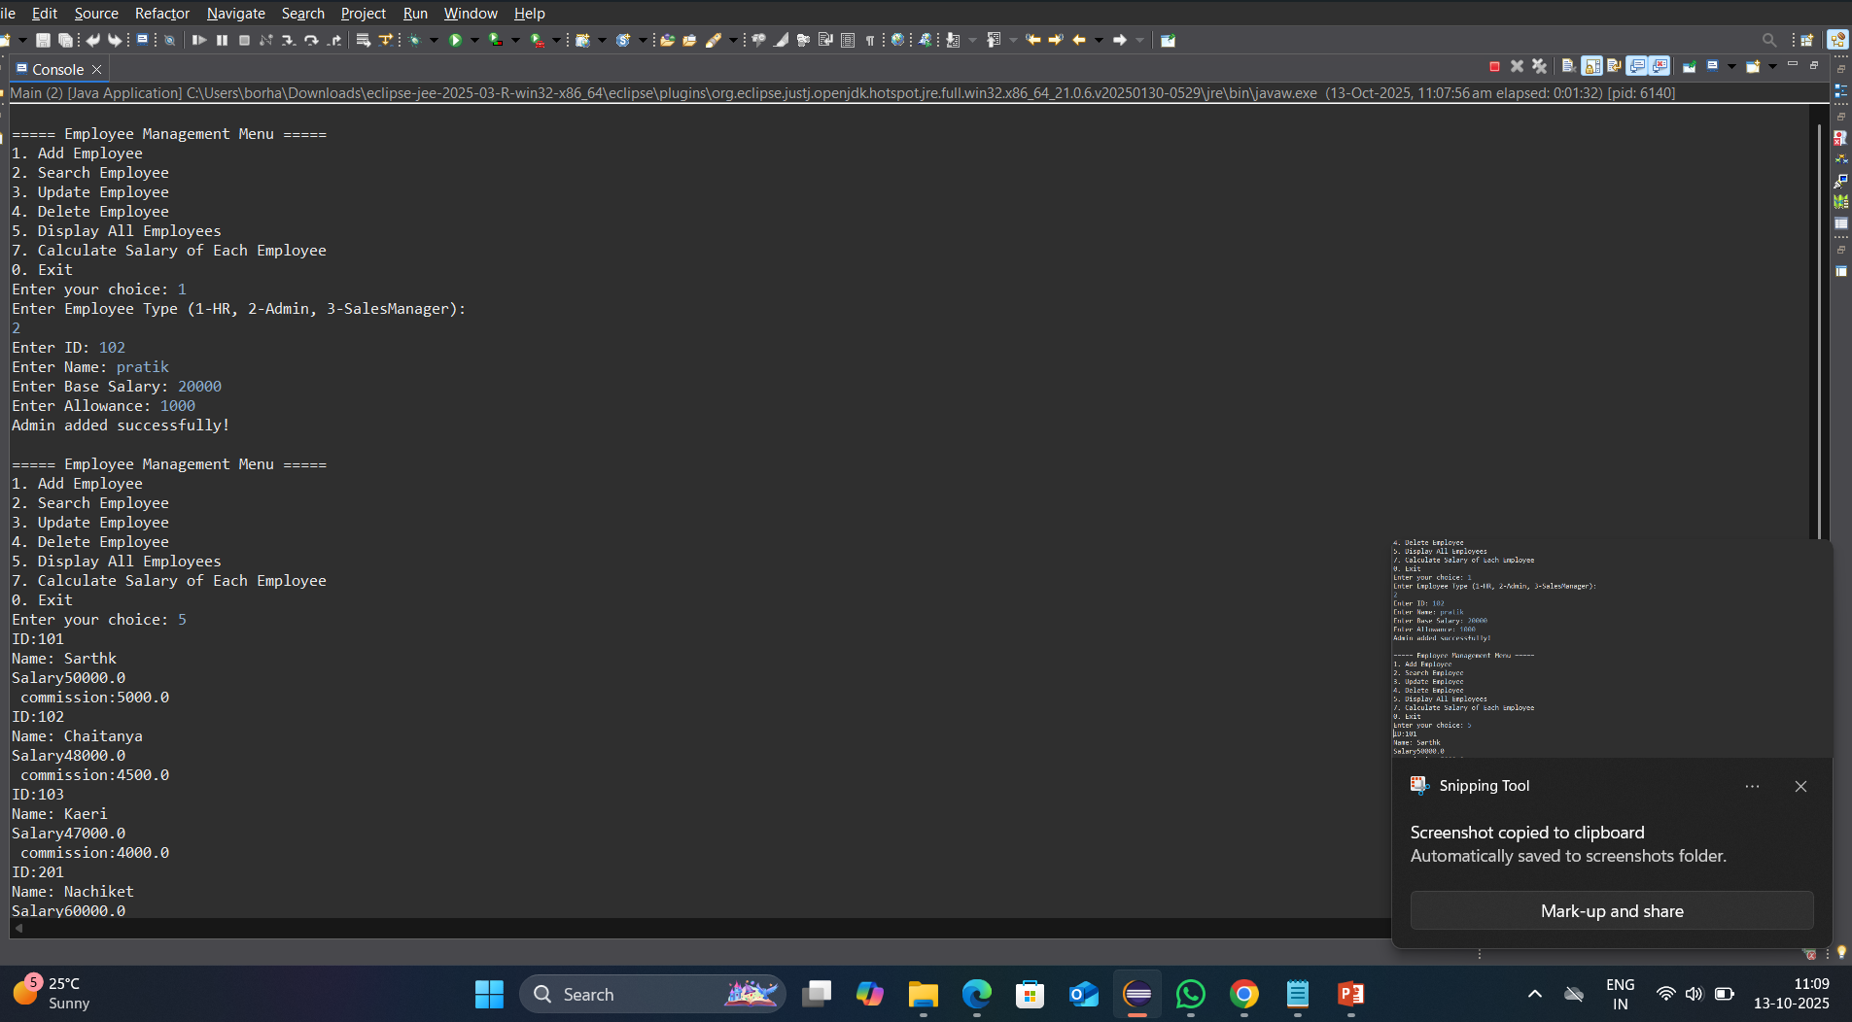
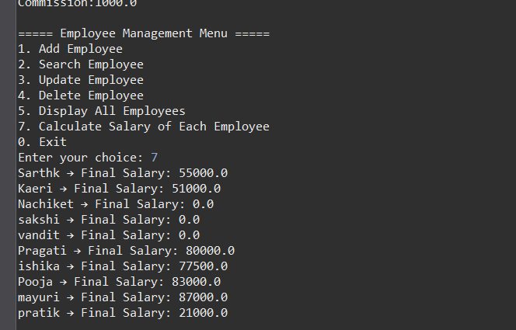

Slide 8
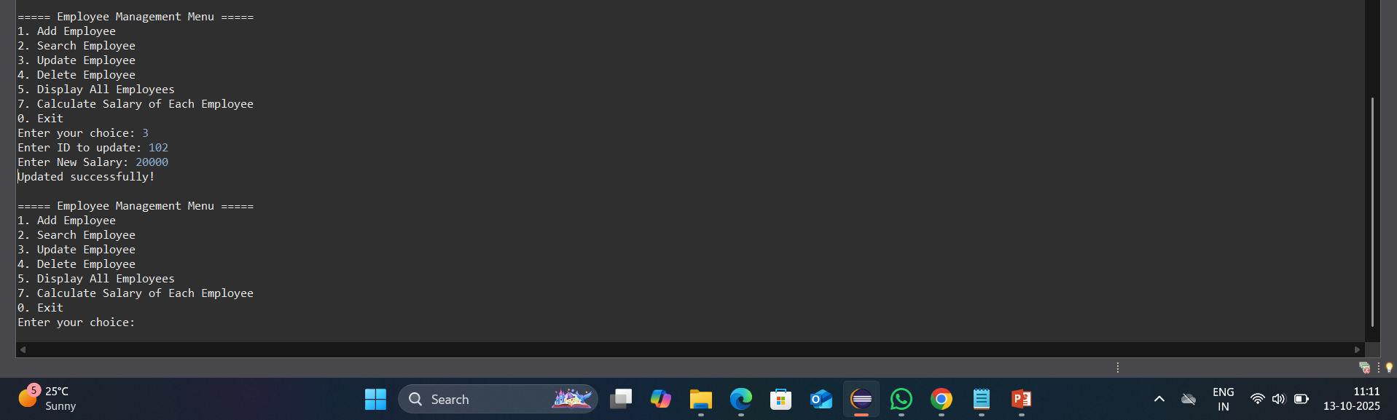
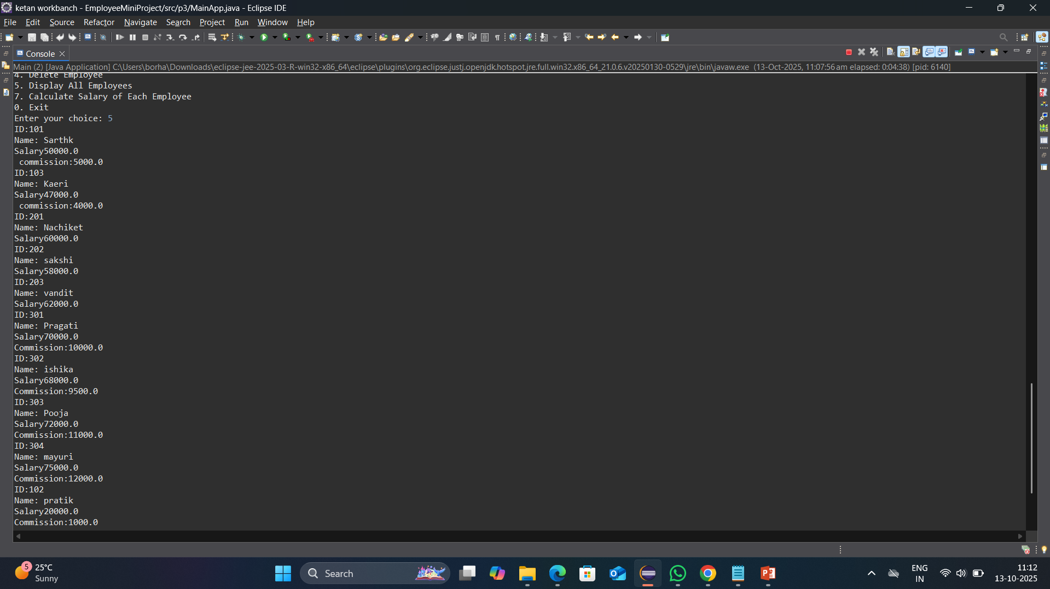

Slide 9
Summary
The Employee Management System showcases Java OOP concepts:
• Abstraction and Inheritance
• Polymorphism and Encapsulation
• Efficient data handling using ArrayList
This project demonstrates a practical implementation of real-world employee management using Java.

